Slide 1
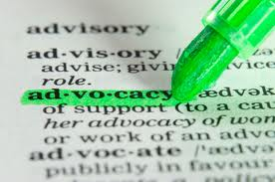
Advocacy!!
Go tell people how cool you are!

Slide 2
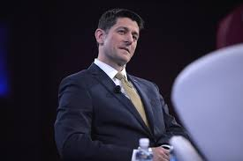
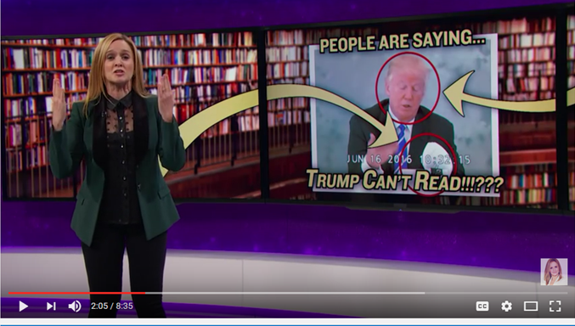
Libraries Need YOU!
Not a lot of library love going on here.
We need to get active in telling people about our great stuff!!

Slide 3
What are we doing here??
When you leave this session you will have some basic skills and ideas:
overview of the advocacy process
identification of your library's elected representatives
a draft email to send to each of them
a set of talking points about your library's value
an elevator speech to share your accomplishments
details on library service nationally, for easy sharing

Slide 4
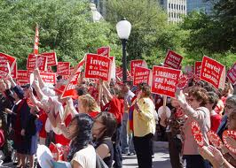
What is advocacy???
Very simply, this is your chance to get people working with you and believing in you
This is your chance to tell people about your awesomeness!!
Services
Materials
Programs
Staff
Website
Outreach

Slide 5
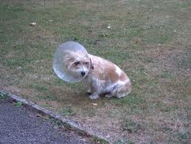
Don’t be pathetic!
No cones of shame for us!
I see a lot of libraries around the country doing AMAZING things, and am DEVESTATED they don’t tell anyone about it!
Think about all the cool things your organization does – all the fantastic things it could do!
Don’t sell yourselves short!!!

Slide 6
Steps to Build a Successful Advocacy Coalition

Slide 7
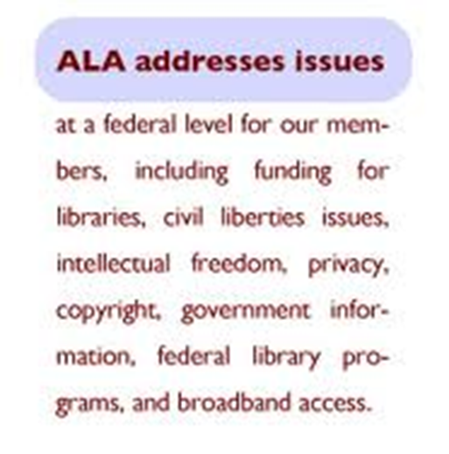
Define Objectives
Define the issue and the coalition’s objectives. What is the issue from your organization’s point of view? What is the coalition trying to accomplish by coming together?

Slide 8
Identify Stakeholders and Possible Allies
What other organizations or stakeholders will benefit from this legislation?
Look beyond “the usual suspects” − think outside of the box in looking for allies.
Find the right mix − coalitions of organizations that are frequent political opponents can be powerful.

Slide 9
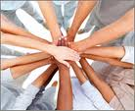
Recruit Coalition Partners
Strategize how to maintain, balance and control diverse/disparate groups.
Be clear and straightforward in recruiting coalition partners. Tell them what’s in it for your organization and show them how their organization can benefit.

Slide 10
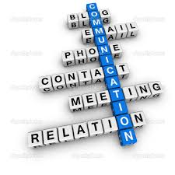
Create a Communication Network
Identify a person who can be depended upon to perform all internal coalition communication.
Identify a single spokesperson for all public communication.
Communicate often, openly and with all coalition partners.

Slide 11
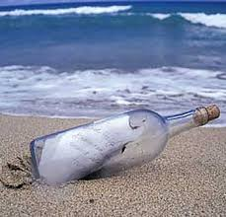
Develop a Message
Keep it simple.
Keep it local and make use of your coalition members’ locations by crafting the coalition’s massage to fit local audiences.
Keep it relevant. The message should reflect the concerns of the audience.
Repeat your message over and over (and over again).

Slide 12
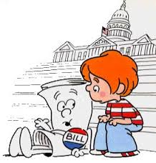
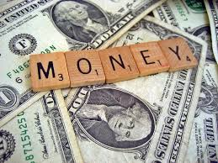
Let’s talk to the politicians!

Slide 13
Finding these people:
Easiest way: Google!
Federal
Senate: http://www.senate.gov/general/contact_information/senators_cfm.cfm?State=MN
House: http://www.house.gov/representatives/#state_me
State
Governor and Executive branch: https://mn.gov/portal/government/state/governor-and-officials/
Legislature: https://mn.gov/portal/government/state/legislature/ and https://www.leg.state.mn.us/leg/DistrictFinder
Local
Google your city’s website
Check your school’s website for board members

Slide 14
What to say???
Make a single point!
Address it to the politician; know it will be read by the intern
Email? Could be postcard, or letter, or package
State your key message right away
Tell them who you are: Librarian from Nifty Library
Mention prior help/good votes from them
Lay out your facts in bullet point form.
Wrap it up with a request for specific action
Say thank you; offer to provide more information

Slide 15
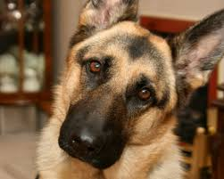
Prepping your elevator speech
You have 60 seconds to make an impression, make your point, and be a magnificent winner!
Just do this:
Quick
Concise
Articulate
Have an outcome in mind
Practice!
Dogs are great at listening to these!

Slide 16
Library advocacy material
Be prepared to whip these out at any moment!
58% of adults in the US have public library cards
90% of Americans say the closing of their local public library would impact their community and 67% said it would affect them and their families
Library users are more involved in their communities (Pew) and vote more frequently than non users
Sample video advocacy projects
Save the Troy Library "Adventures In Reverse Psychology" https://www.youtube.com/watch?v=nw3zNNO5gX0
A Vision Shared: School Board/District Planning for School Library Advocacy https://www.youtube.com/watch?v=ZCZ_DLUP_YA
Librarians Do Gaga https://www.youtube.com/watch?v=a_uzUh1VT98

Slide 17
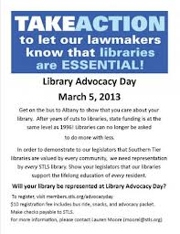
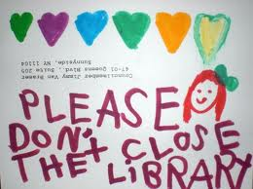
Conclusion:
DO IT!!!!!!

